Slide 1
Healthcare Chat Bot using Python
Submitted
in the partial fulfillment for the award of the degree of
BATCHELOR OF ENGINEERING
IN CSE
Submitted by:
Pippala Sarayu 20B81A0539
Maragani Sreeja 20B81A0545
Kankanala Tejaswi 20B81A0552
Under the Supervision of:
MS. G.Deepika
Assistant Professor
Department of CSE

Slide 2
Outline
Introduction to Project
Problem Formulation
Objectives of the work
Methodology used
Results
Conclusion
Future Scope

Slide 3
Introduction to Project.
Today’s people are busy with their works reception, workplace work and additional addicted to the web. They are not involved in their health. So they avoid traveling to hospitals for little issues.it may become a significant drawback.
So, we will offer a thought to make a health care chatbot system using AI that may identify the illness and suggest doctor .
The system application uses question and answer protocol within the style of a chatbot to answer user queries. The response to the question is replied supported by the user question.
The system is developed to scale back the tending price and time of the users because it isn't potential for the users to go to the doctors or consultants once in real-time required.

Slide 4
Problem Formulation
Chatbot is an Entity that imitates human discussion in its particular accepted set-up together with a text or vocal language. The aim of this system is to replicate a person’s discussion.
The system gives a response by use of an efficient Graphical User Interface such that if an actual person is chatting with the user.
Chatterbot that can be used in various fields like education, healthcare, and route assistance. The system takes user action as input and identifies disease ,suggests doctor ,and other symptoms related to disease

Slide 5
Objectives of the Work
Our main objective is to spread awareness and make the application easily reachable to every person in the village.
In rural areas of India, people don’t have access to health services, we’re filling this gap by connecting them with nearby doctors as well as doctors in urban areas via our application.
To extract symptoms from user action.
To classify and predict the diseases using a decision tree.
To develop a healthcare chatbot to predict diseases by symptoms taken as input and suggest a doctor

Slide 6
Methodology used
The following methodology are followed to achieve the objectives defined for the proposed project work:
A detailed study of health care chatbots is done.
Installation and hands-on experience on existing approaches of health care chatbot is done. Relative pros and cons are identified.
A comparison of the newly implemented approach with existing approaches is done.

Slide 7
Methodology used
For a conversation between user and system and software used are Python , Tkinter, Numpy, Pandas.
The healthcare chatbot is designed by using python
For a conversation between user and system we used Python(Tkinter model)
The dataset files are CSV file format which is trained in the initial stage of the application mode and also used as testing mode.
sklearn library is used to implement machine learning algorithms

Slide 8
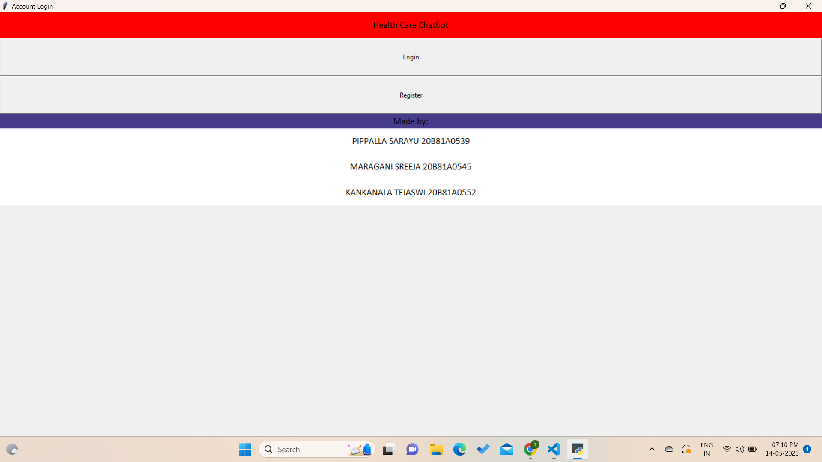
Results

Slide 9
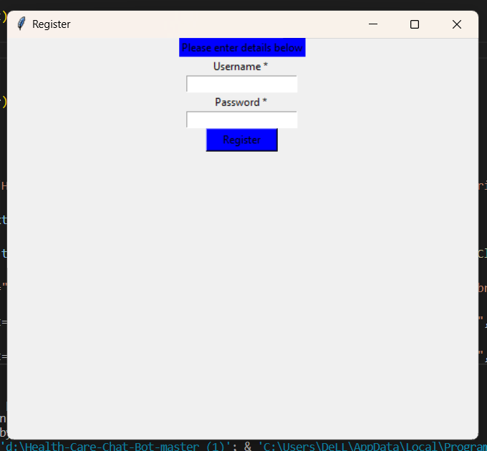
Results

Slide 10
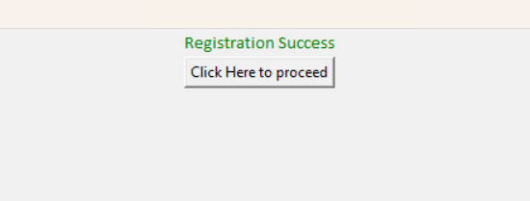
Results

Slide 11
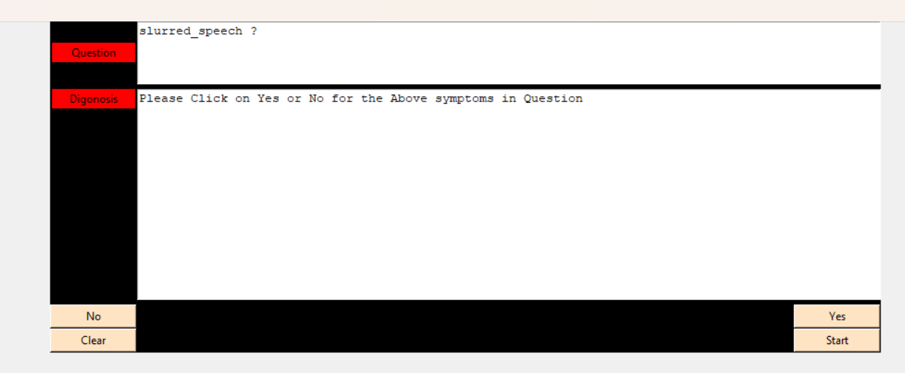
Results

Slide 12
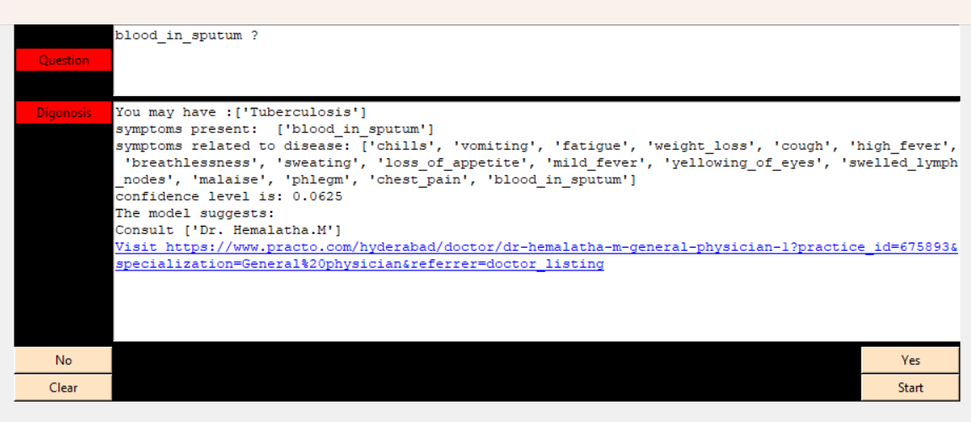
Results

Slide 13
Conclusion
Chatbot is a great tool for conversation language between humans and machines. The application is developed for obtaining a fast response from the bot which implies with no delay it provides the correct result to the user. It’s ended that, the usage of chatbot is user friendly and might be utilized by someone who is aware of the way to sort in their own language.
Currently, chatbots are not supported by everyone's language and cannot understand informal language. Hence, there is good scope to remove such language barriers from chatbots. Embedded AI helps the computer system function like a human.AI chatbot making our chatbot capable and intelligent to answer complex queries. With the help of AI Chatbot, you can improve the current answer using the previous interaction. Such a chatbot system conducts intelligent interactions and saves the customer time.

Slide 14
Future Scope
Future scope of the project could be an AI-Based Healthcare chatbot system that can also include a mobile assistant in it which will be more functions will be added and can be accessed by many users.
Which will also reduce the time and will also be accurate in the health details of patients given to the doctors.
Future scope of this healthcare chatbot system will help hospitals to provide healthcare support online 24 x 7, it answers deep as well as general questions.
It also helps to generate leads and automatically delivers the information of leads to sales. By asking the questions in series it helps patients by guiding what exactly he/she is looking for.

